Slide 1
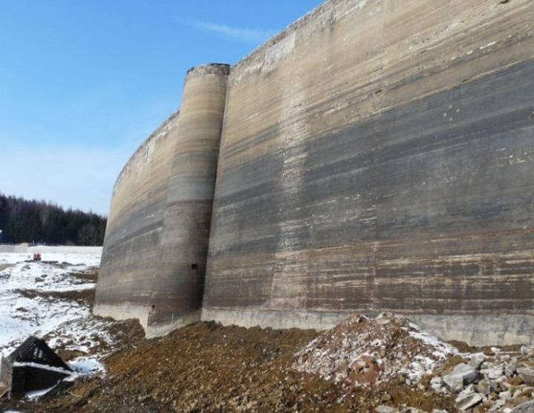
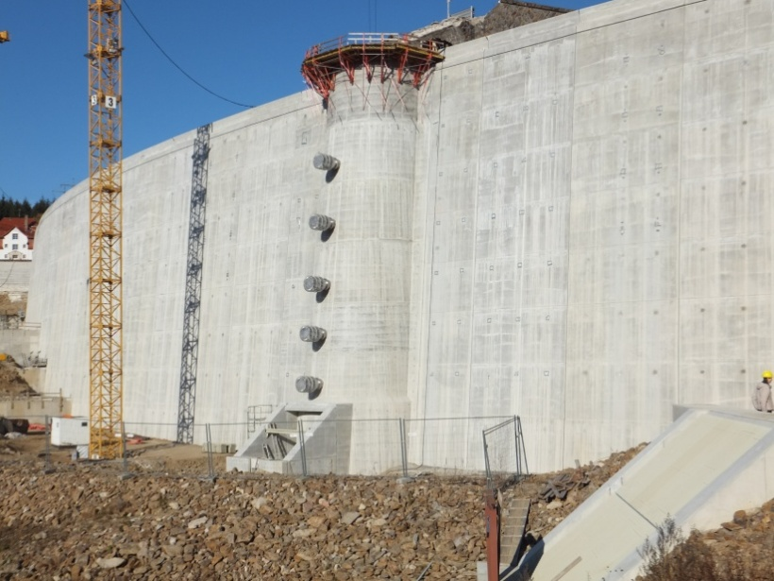
Rehabilitation of Klingenberg Dam – now fit for another 100 years
Michael HEILAND (Managing Director, Lahmeyer-Hydroprojekt Weimar, member of chair of GermanCOLD)
Dr. Hans-Ulrich SIEBER (Managing Director, State Reservoir Administration of Saxony, chairman of GermanCOLD)
French Dam Symposium, Grenoble, 31.January 2014

Slide 2
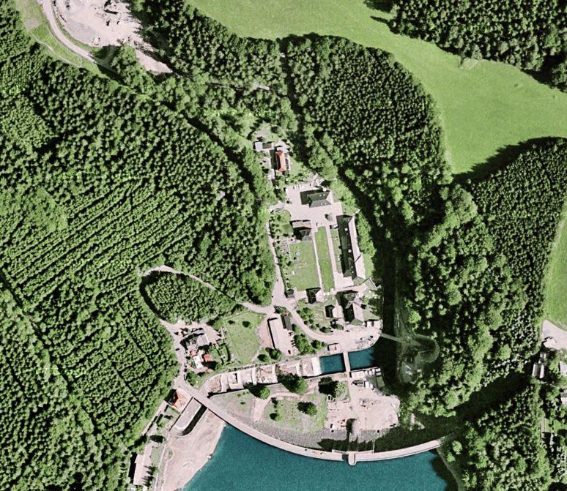
Content
Introduction
Objectives, callenges
Phase 1 of rehabilitation
Raw water replacement
New by-pass tunnel
New pre dam
New inspection gallery
Phase 2 of rehabilitation
Dam body
Spillway, cascade, stilling basin
New Intake tower
Technical equipment
Sediment removal
Conclusion

Slide 3
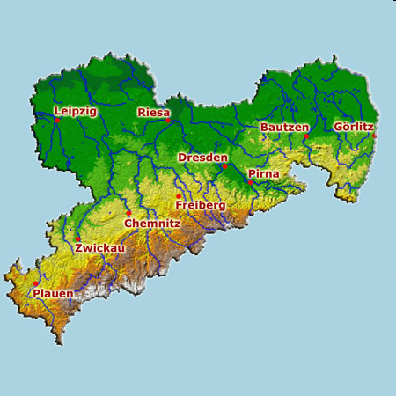
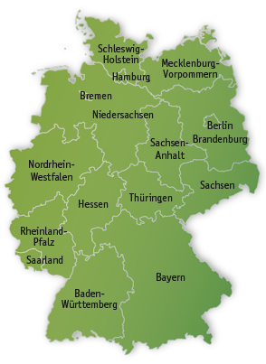
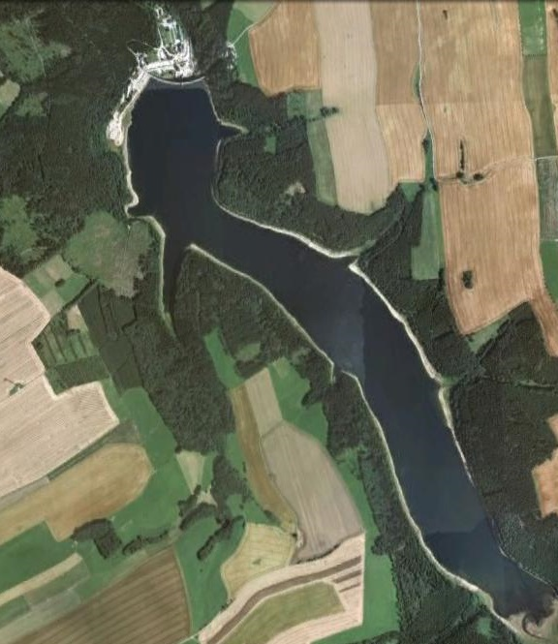
Klingenberg Dam
Klingenberg
Freestate of Saxony

Slide 4
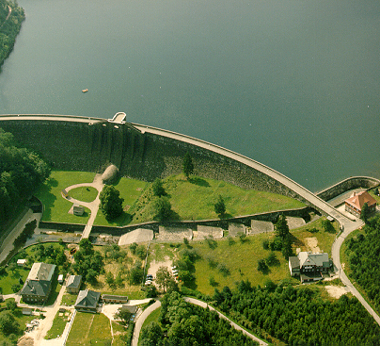
Klingenberg dam - technical details
Catchment area (incl. Czech Republic | 89,4 km² 12,3 km²)
Total storage | 17,5 Mio. m³
Reservoir area at operation level | 1,16 km²
Height above foundation level | 40 m
Length of the dam crest | 310 m
Width of the dam crest | 6,2 m
Volume of the dam body | 118 000 m³
Water supply | 1 000 l/s
Design flood _{earlier} _{(before 2002)} | 95 m³/s
Normal design flood _{new} | 145 m³/s
Maximum design flood _{new} | 225 m³/s
Type of the dam: Masonry gravity dam with upstream concrete cover and with curved axis (principle of Intze)
Time of erection: 1908-1914

Slide 5
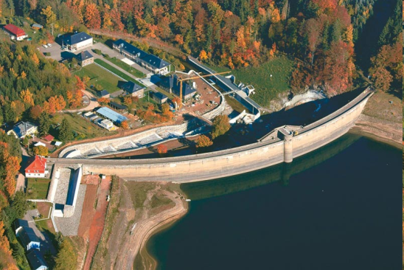
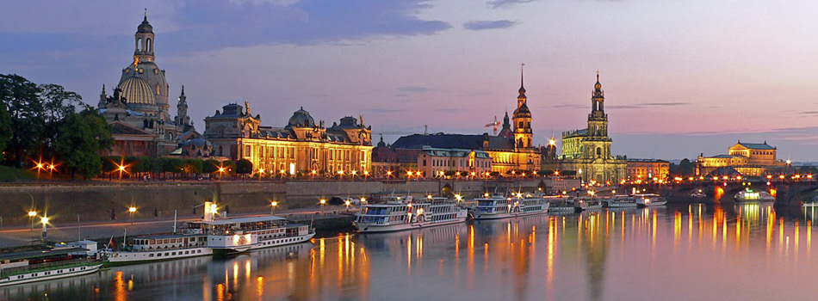
Klingenberg dam - facts
ageing based problems after 90 years in operation
flood-related damages (extreme flood 2002)
dam rehabilitation 2006 - 2013
drinking water supply & flood control for City of Dresden

Slide 6
Klingenberg Dam - Objectives of the rehabilitation
Preservation of the structural substance of the 100 years old dam
Safeguarding of the function of the dam at least over further 80 years
Repair of the damages caused by the extreme flood in August 2002
Adaptation to the state of the art and to German technical standards for dams
  Modernisation of facilities for monitoring & control, ensuring safe operation of the dam
  Improvement of dam safety against overflowing by means of encreasing the capacity of existing spillway and additional spillway tunnel (by-pass tunnel from the upstream pre-dam to downstream of the main dam)
Reconstruction of the water intake and outlet works in order to improve water management with respect to water quantity and water quality (limnology)

Slide 7
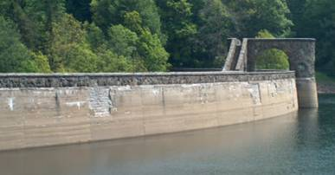
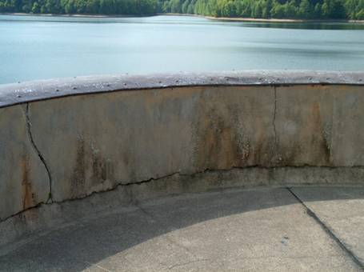
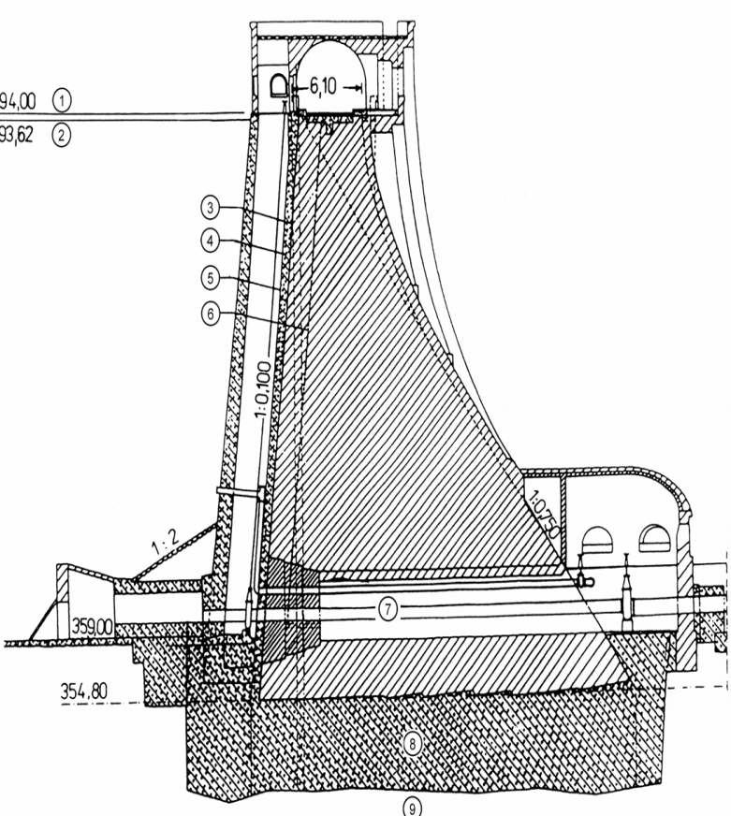
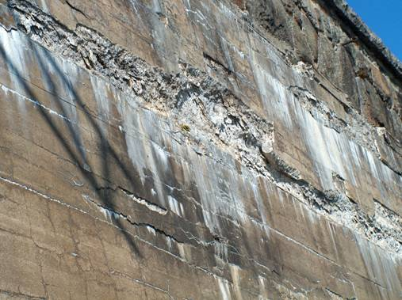
Klingenberg dam - Damages at the upstream face of (ageing)
unsuitable facibilities for the water management

Slide 8
Klingenberg dam
Spillway cascade during extreme flood in August 2002

Slide 9
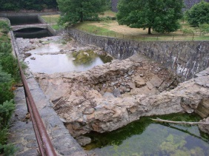
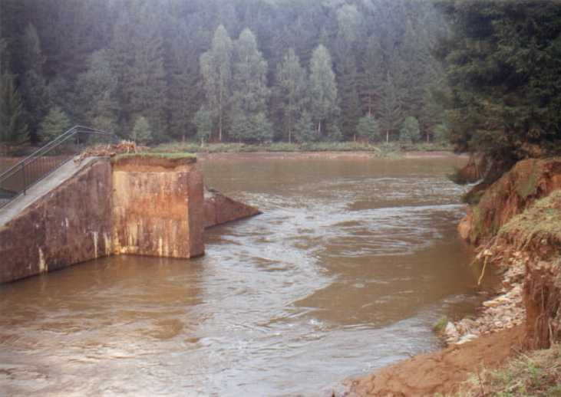
Klingenberg dam - Serious damages due to the extreme flood in August 2002
at the spillway, cascades and stilling basin
at the pre-dam
(destruction by overflooding)

Slide 10
Klingenberg dam - Special challenges of the rehabilitation
To guarantee the raw water supply of the waterworks according to demand (average 1 m³/s, max. 1,28 m³/s) during the rehabilitation of the dam
without interruption during empty reservoir over approx. two years
Temporarily replacement of water supply from Klingenberg reservoir by a system of other existing reservoirs connected by pipelines and tunnels
To ensure water quality sufficiently suitable for the conditions in the waterworks
Maintain flood protection in the Weißeritz river valley continously by retaining of 9 Mio. m³ water in the system consisting of Klingenberg dam and the upstream situated Lehnmuehle dam

Slide 11
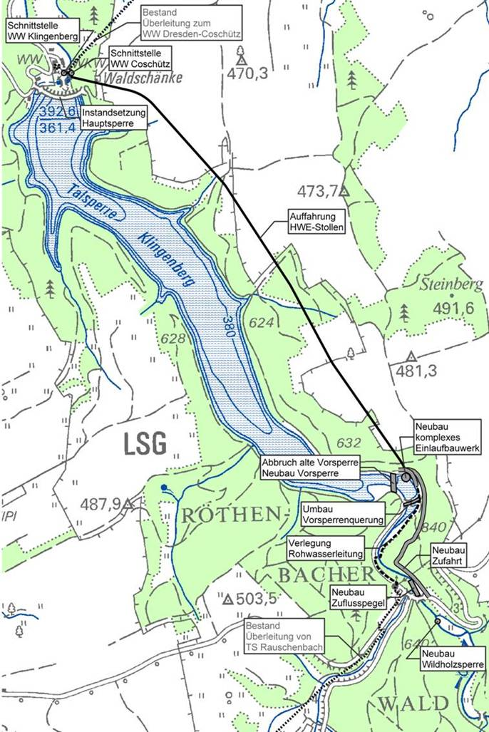
Klingenberg dam - Rehabilitation measures from 2005 to 2013
Phase 1: 2005 – 2009
Construction of a new by-pass tunnel (TBM)
Removal of the destroyed old pre-dam and erection of the new pre-dam
Installation of the facilities for replacement of the raw water of the Klingenberg reservoir
Excavation (blasting) of the inspection gallery in the main dam (at impounded reservoir)
Erection of appurtenant works (e.g. water-depth gauges)
Phase 2: 2009 – 2013 (empty reservoir 2010 -2011)
Reconstruction of the upstream face, the crest and the downstream face of the main dam
Rehabilitation of the spillway, the cascade and the stilling basin
Installation of technical equipment (water intakes, outlet works, monitoring systems)
Removal of parts of sediment from reservoir bottom

Slide 12
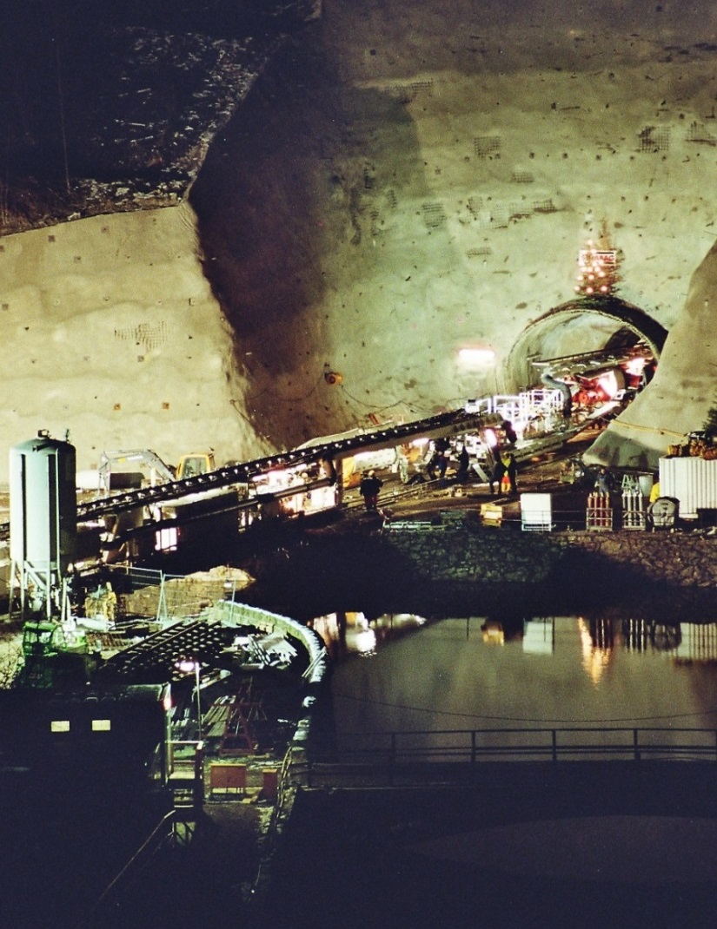
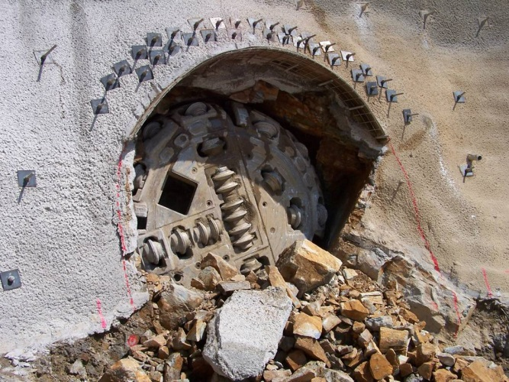
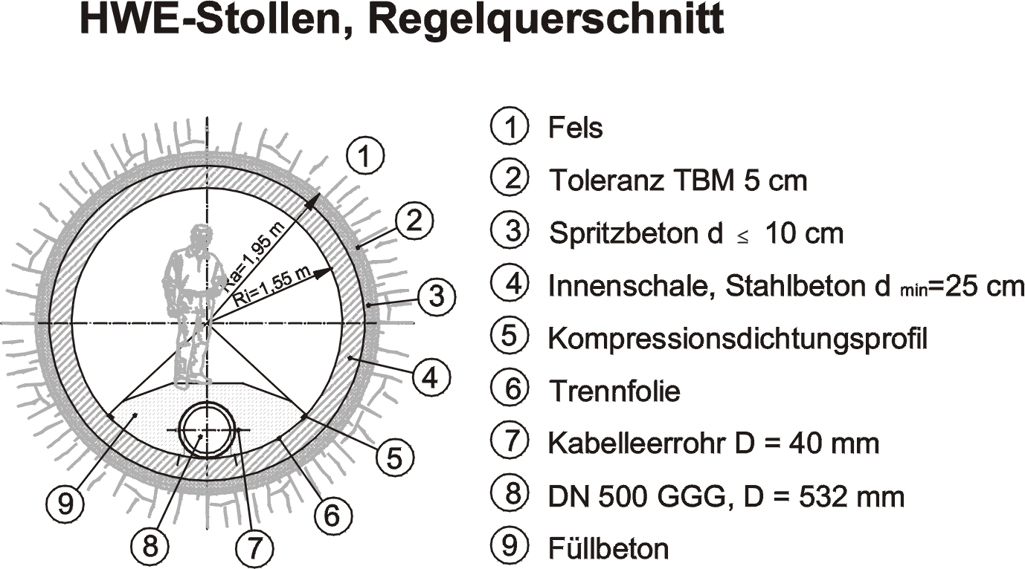
By-pass tunnel (flood & raw water tunnel) under construction, 3.2 km

Slide 13
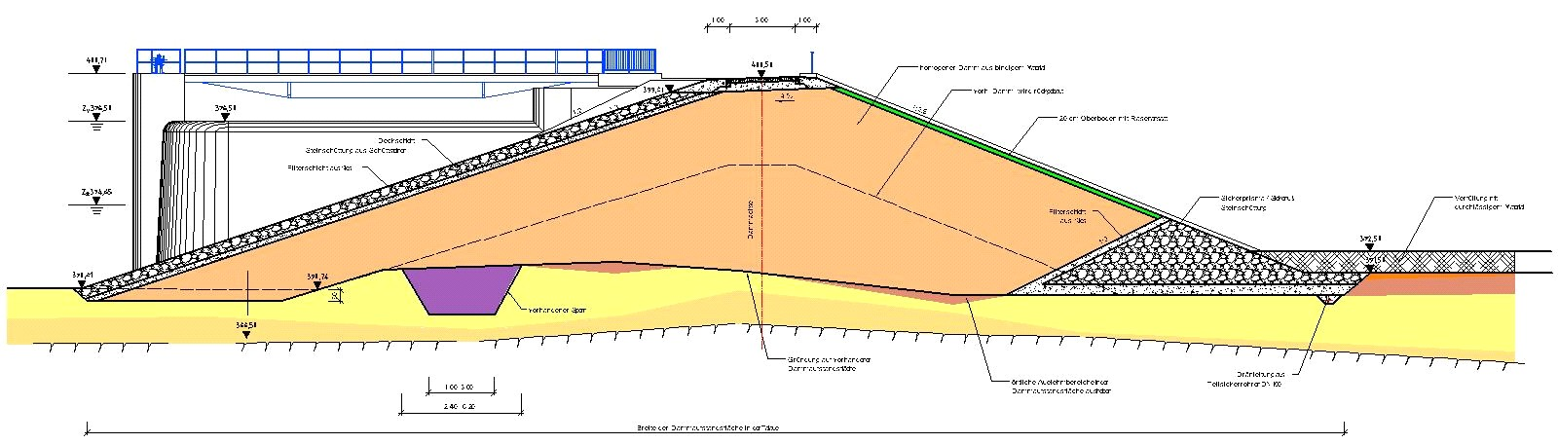
Klingenberg Dam - Cross section of new homogeneous pre-dam

Slide 14
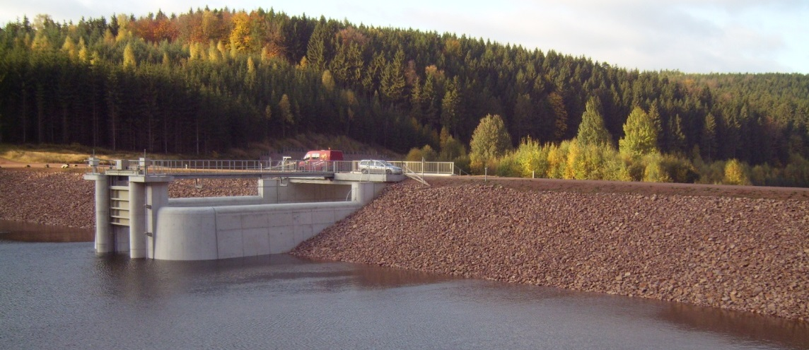
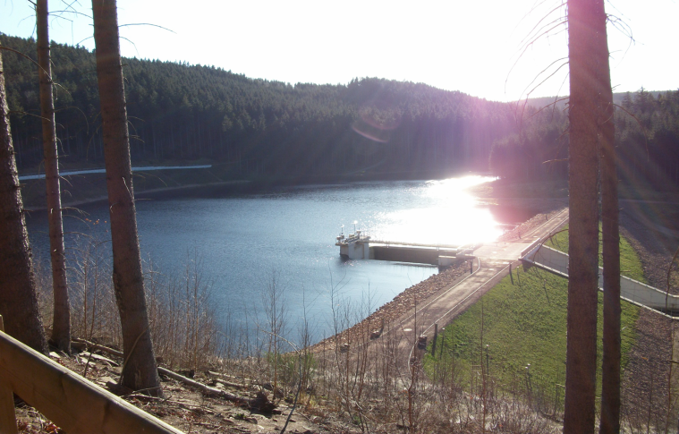
New pre-dam of the Klingenberg reservoir after impounding

Slide 15
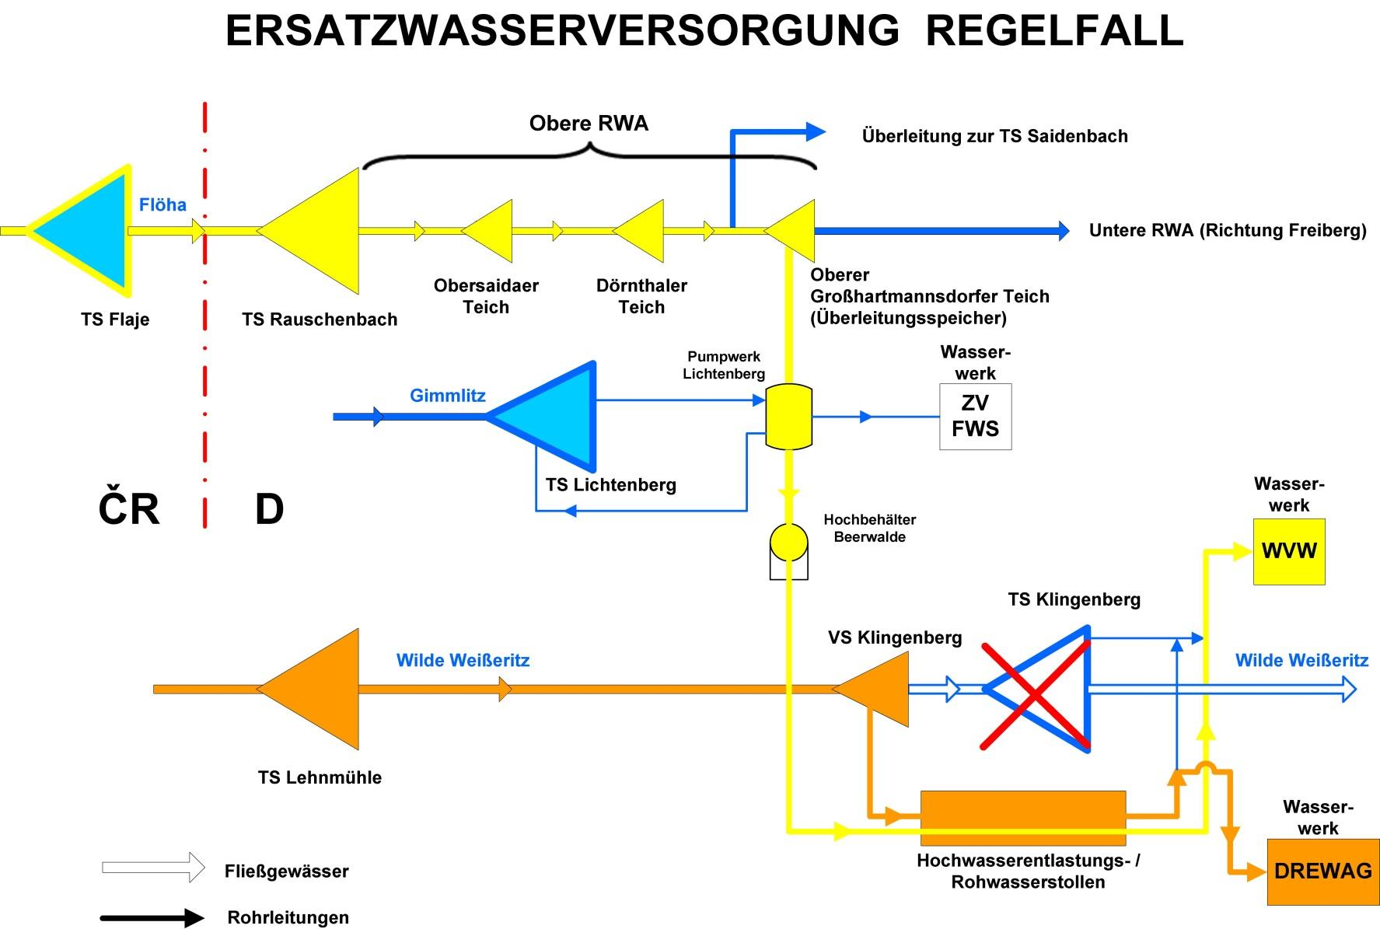
Temporary replacement of raw water from Klingenberg dam
By-pass tunnel

Slide 16
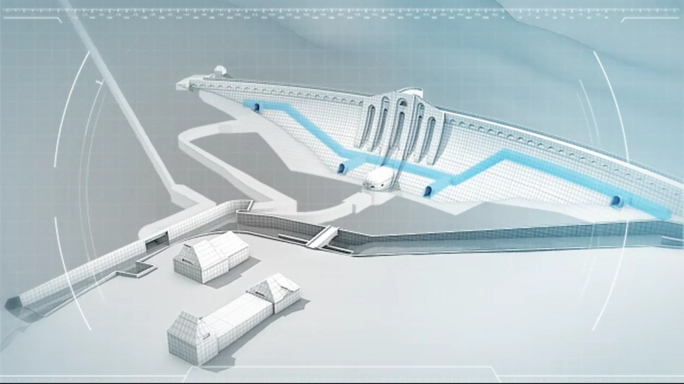
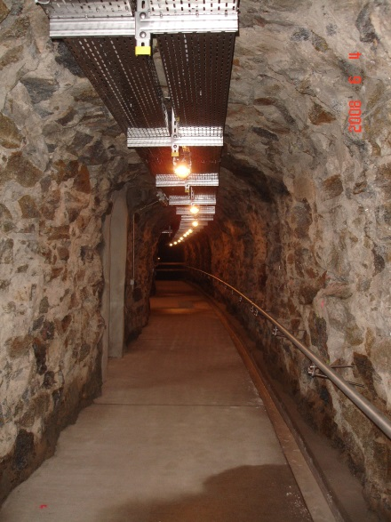
New inspection gallery throughout the Klingenberg dam
gallery after completion

Slide 17
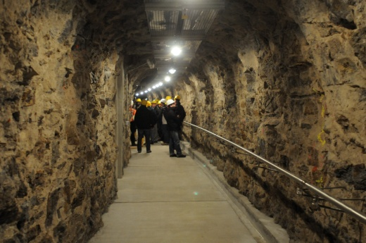
Klingenberg Dam - New Inspection Gallery
excavation under full reservoir level
30 m head, min. distance to u/s face 3 - 5 m
"drill and blast" method
l = 245 m, A = 6 m² (w/h 2.0 m / 2.90 m)
2 m / working day average advance rate
4 tons total explosive consumption
state of stress calculation due to blast exposure
measurement program
excellent material properities - no liner required
installation of dam instrumentation systems

Slide 18
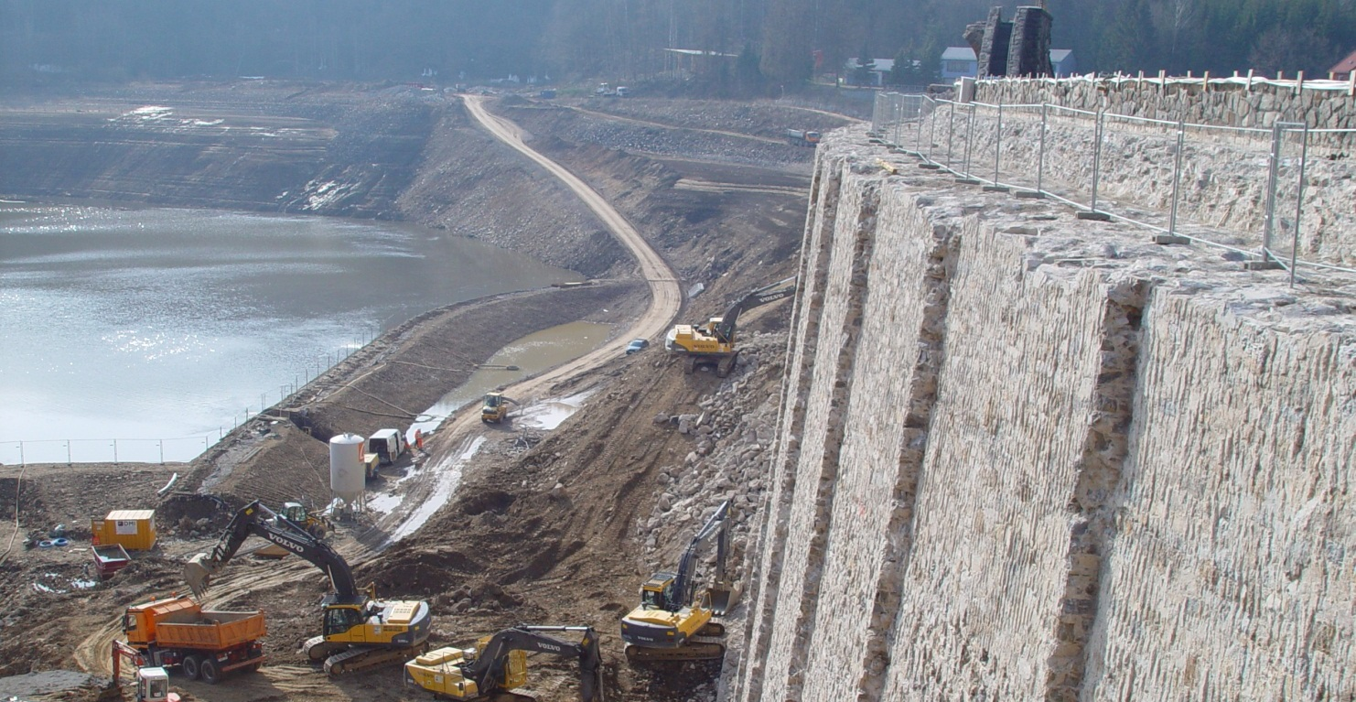
Klingenberg Dam - Reconstruction of the dam body
Demolition of the upstream concrete cover and dam crest

Slide 19
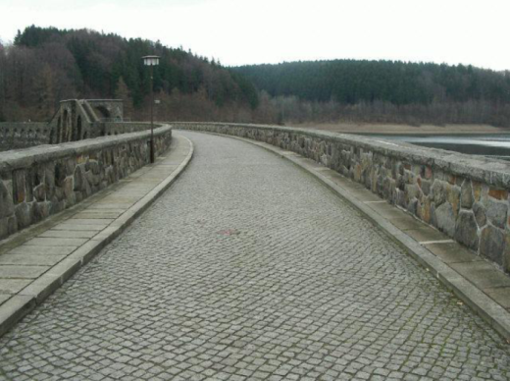
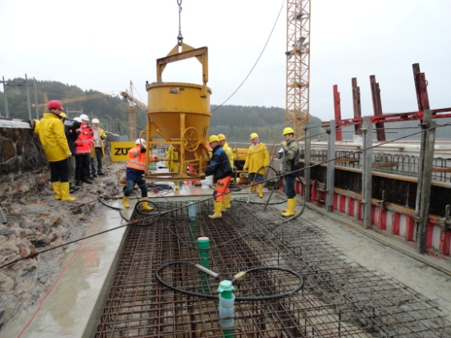
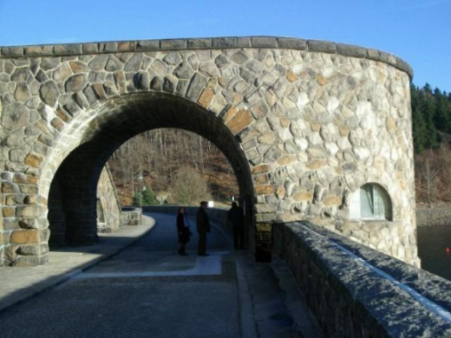
Reconstruction of the dam crest
problem: no seal, seepage, lime mortar outbreak, discharged on d/s face
  leach flags
  decay due to frost
  leaching of the masonry
solution: removal, new construction
crest plate = toe of the parapet wall = top end of the upstream sealing layer
sealing layer + 40 cm (wave action safety - DIN 19700)
partial demolition of crest building – enlarged modestly
rehabilitation in compliance with German monument preservation order

Slide 20
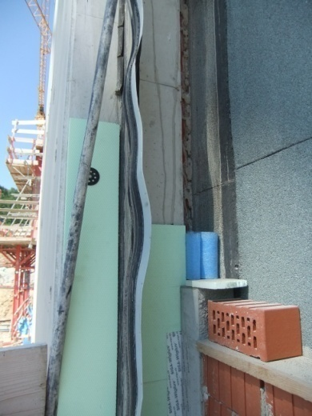
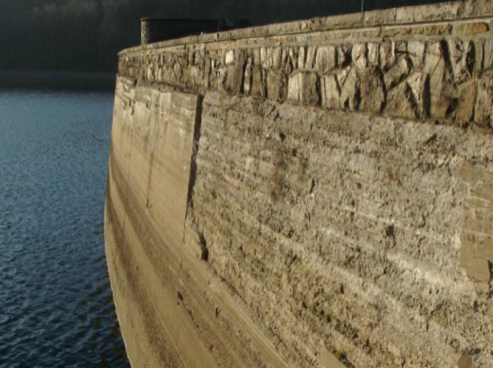
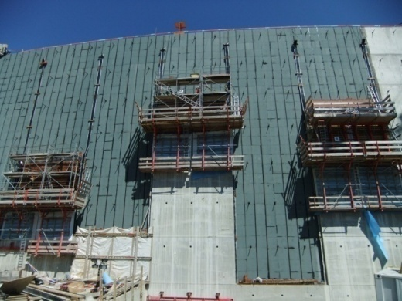
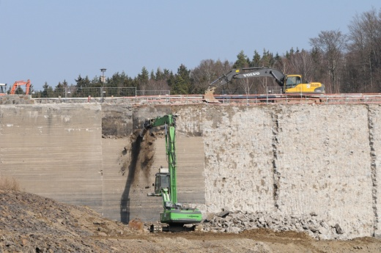
Reconstruction of upstream sealing
damage of old cement mantle (compressed concrete)
dismantling of ’Intze’-wedge, protective facing, foundation
new sealing (h = 34 m)
grouting at u/s dam toe
sealing wall:
  sealing layer (reinf. concrete 40 cm, w/h 8/4 m)
  drainage layer (bricks, seepage detection)
  sliding layer (bitumen sheet)
  compensation layer
elastomeric water stop (joint tape and plates)
570 rock bolts anchored in the dam

Slide 21
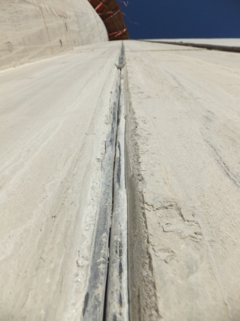
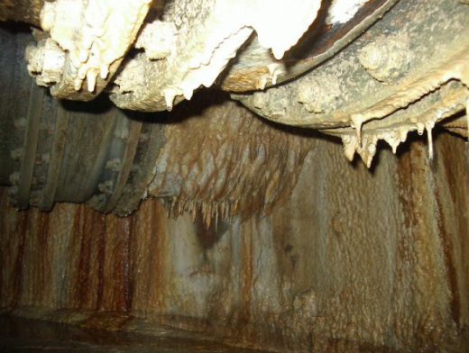
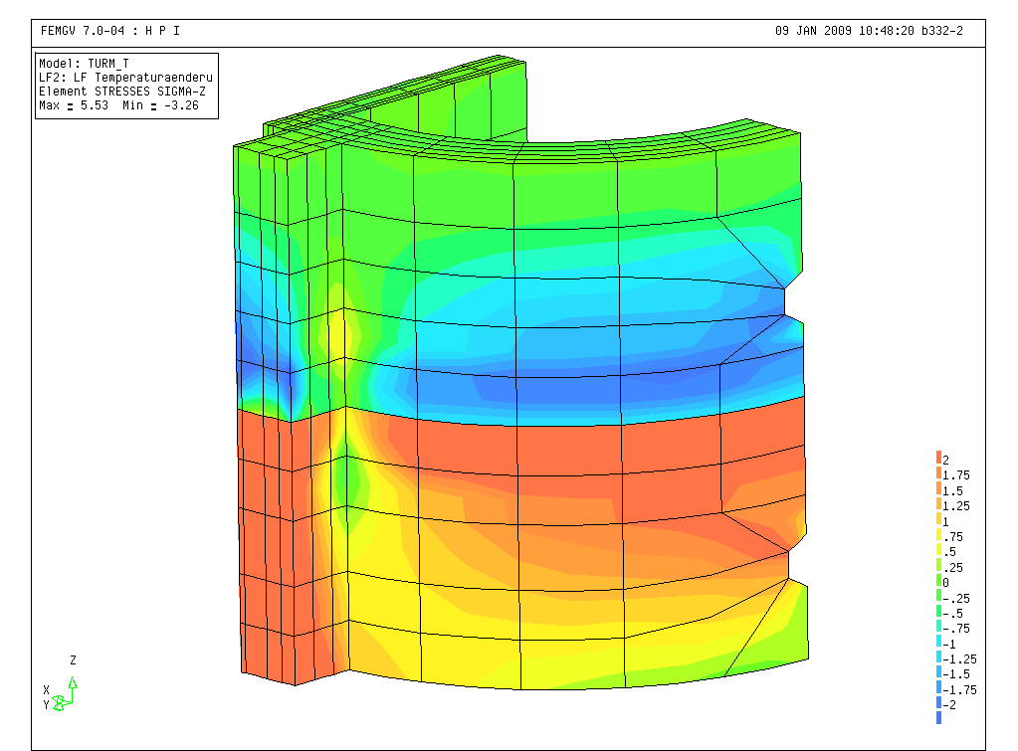
Klingenberg Dam - New intake tower
problem 1: decay, massive leaching
  high hydraulic gradient in the tower wall
  relatively high permeability of the concrete
  mix-formula of used binder
problem 2: increased space required for the new pipelines
solution: demolition and new construction (increased semi-cylindrical ground-plan)
8 Stories, freight elevator, stairway
3-D FEM-analysis
connection with the sealing wall by sealed expansion joints

Slide 22
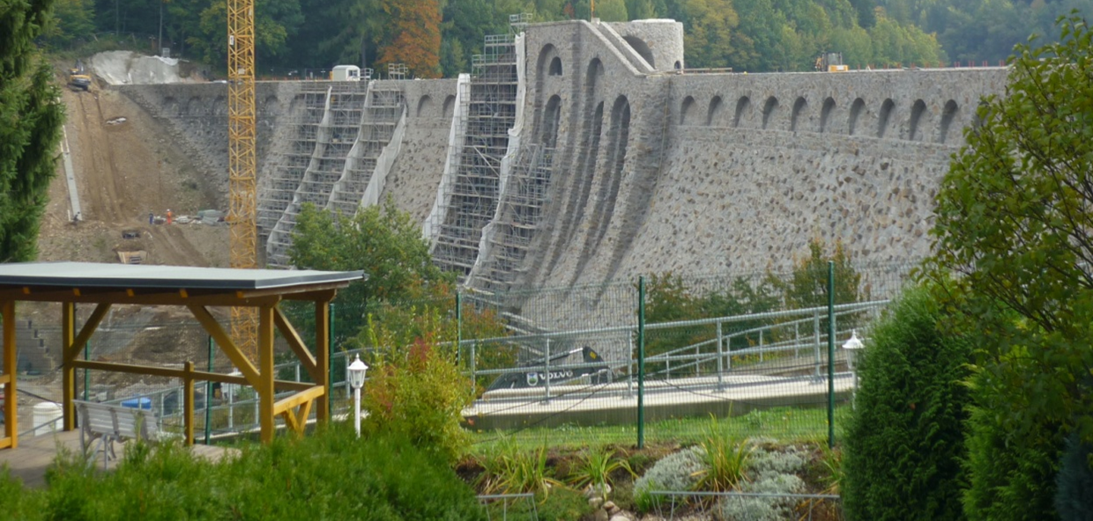
Klingenberg Dam - Repair of downstream face of the dam
damage of old joints with partly heavy vegetation
danger of falling stones
joints and stones cleaned with high pressure water jet and grouted
rehab of joints in compliance with monument preservation order
renovated downstream dam face stands out visually

Slide 23
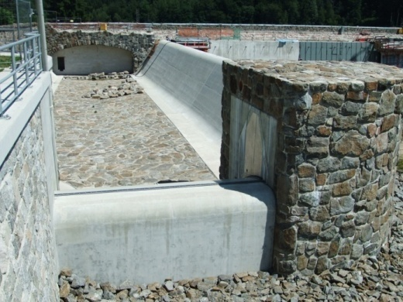
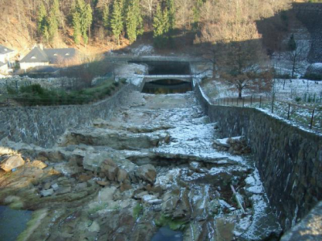
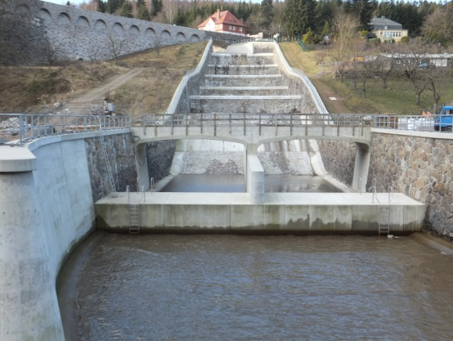
Klingenberg Dam – Cascade Spillway
flood 2002: hydraulic overload, massive damage
new design flood inflows HQ1,000 = 145 m³/s, HQ10,000 = 224 m³/s
  completely new inlet design, cascades and stilling basin in compliance with monument preservation order
  hydraulic model tests (scale 1:30)
new side channel l = 50 m, flap gate w = 6.3 m
  cascade: guidance wall, side walls partially increased, first step omitted, steps edged with concrete frame
  deepening of stilling basin t = 0.4 m
  new end sill h = 2.4 m
new bridge
deepening of collection channel
removing of existing end sill

Slide 24
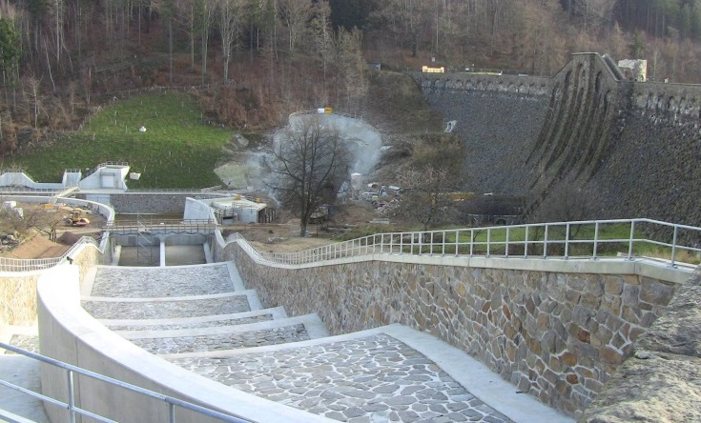
Klingenberg Dam - Spillway cascade after rehabilitation

Slide 25
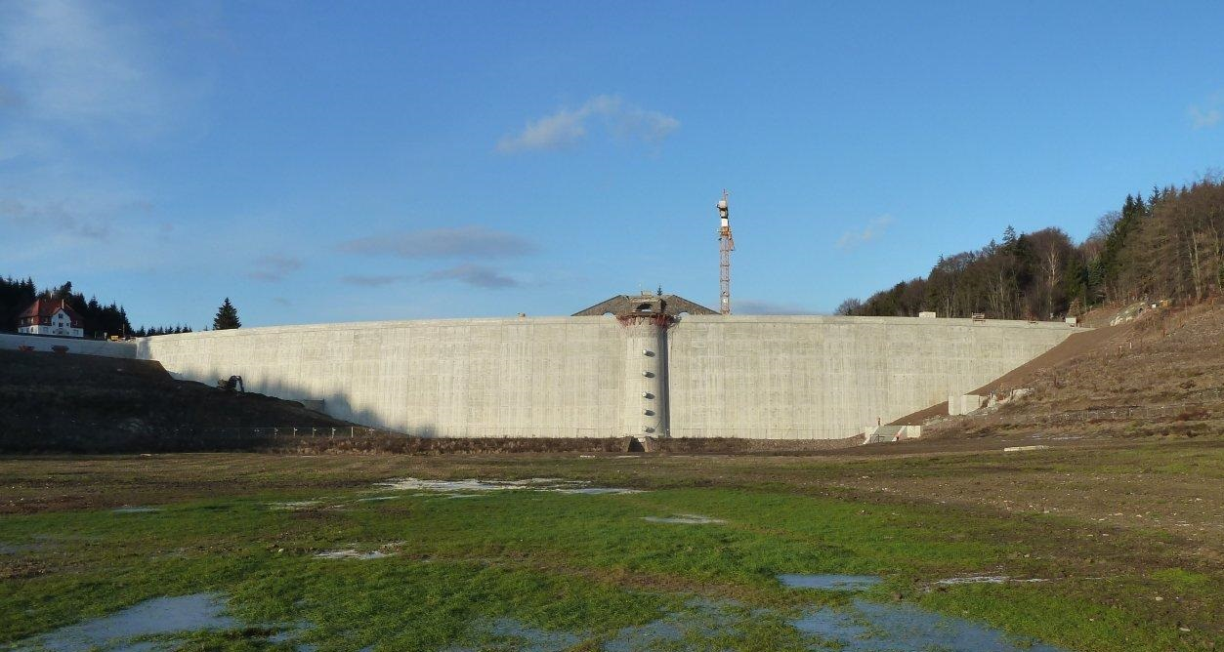
New upstream face consisting of a watertight reinforced concrete wall

Slide 26
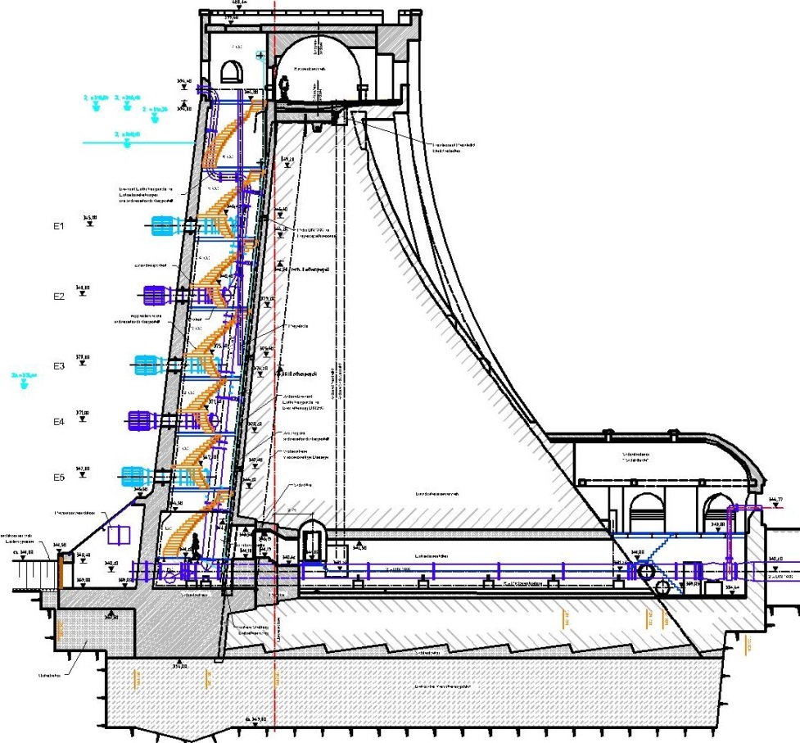
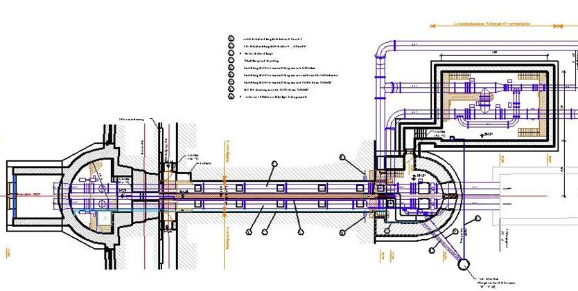
- 5 raw water intakes
- new bottom outlet
Klingenberg Dam - Modernisation of technical equipment

Slide 27
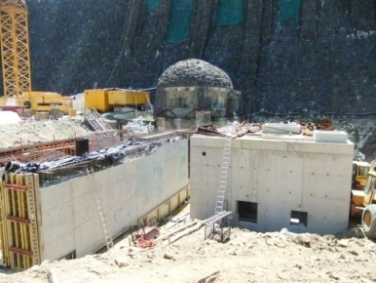
Klingenberg Dam - Bottom Outlet and Raw Water System
construction required a temporary water supply
raw water supply: highest standards (quality / quantity)
former structure: 3 raw water intakes (old intake tower on right side)
problem: limited abstraction of good water quality due to allocation of intake horizons
new: 6 intake horizons in new intake tower
parallel raw water supply and discharge of water with poor quality
subsurface valve chamber

Slide 28
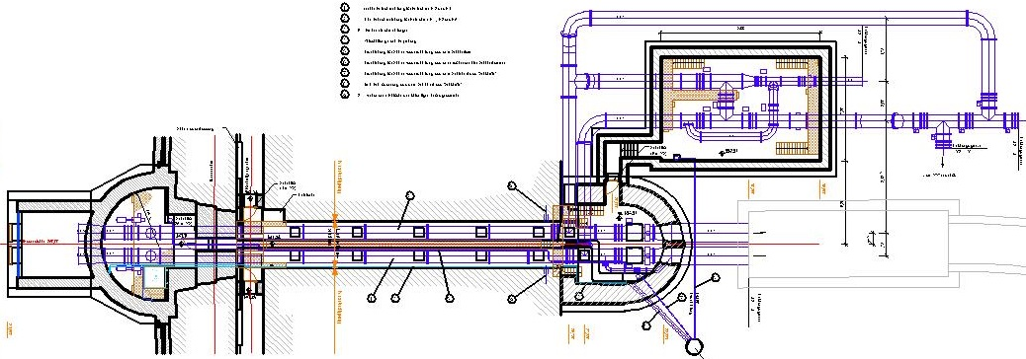
Klingenberg Dam - Bottom Outlet and Raw Water System
Valve chamber
Intake tower
gallery

Slide 29
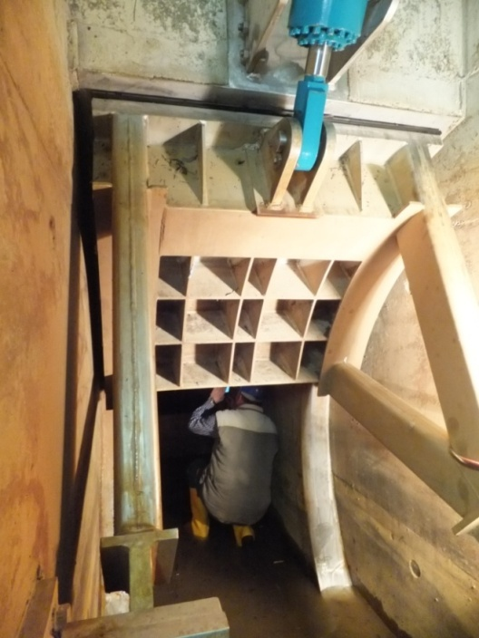
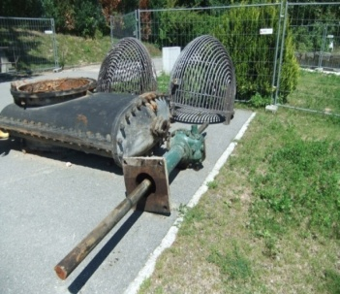
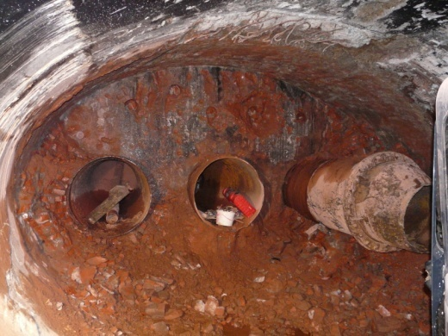
Klingenberg Dam - Bottom Outlet
separation of systems
new bottom outlets in former diversion tunnel (now operated as pressure tunnel l = 160 m, A = 5 m², reinforced shotcrete lining 30 cm thick)
discharge control by combination of vertical lift and radial gate (w / h 0.90 m / 1.20 m)
stilling chamber

Slide 30

Klingenberg Dam - New intake tower with 5 raw water intakes

Slide 31

Klingenberg Dam - Monitoring facilities
designed and installed in close consultation with the client
based on the German code of practice
components added in several stages or structurally installed
installation of automatic measuring station
    water level
  seapage and leakage
  uplift pressure
  seal monitoring
  inclinometer
  joint displacement
  crest and surface alignement
  pendulums

Slide 32




Klingenberg Dam - Removal of sediments nearby the dam
Empty reservoir with relatively minor sedimentation

Slide 33

Reimpoundment of the Klingenberg reservoir (blue line)
according to the test programm

Slide 34

Klingenberg Dam - Conclusions
Rehab. completed in 2013, all tests successfully, regular dam performance
Safe dam operation at least for the next 80 years
Enhanced flexibility of raw water management
Very successful planning, construction and supervision

Slide 35

Herzlichen Dank an die DREWAG Stadtwerke und die Wasserversorgung Weißeritzgruppe für ihre Kooperationsbereitschaft
Thank you very much for your kind attention !

